Slide 1
Internship Work
Aishvarya Akshaya Vishva Raman, Intern 12/07/2021

Slide 2

Table of Contents
Title | (Optional) Page Number
Camunda | 03
SingleStore SQL | 06
Covid Dashboard using Power Bi | 11
[PRESENTATION NAME AND | OR DATE]
[FOR INTERNAL USE ONLY]
2

Slide 3
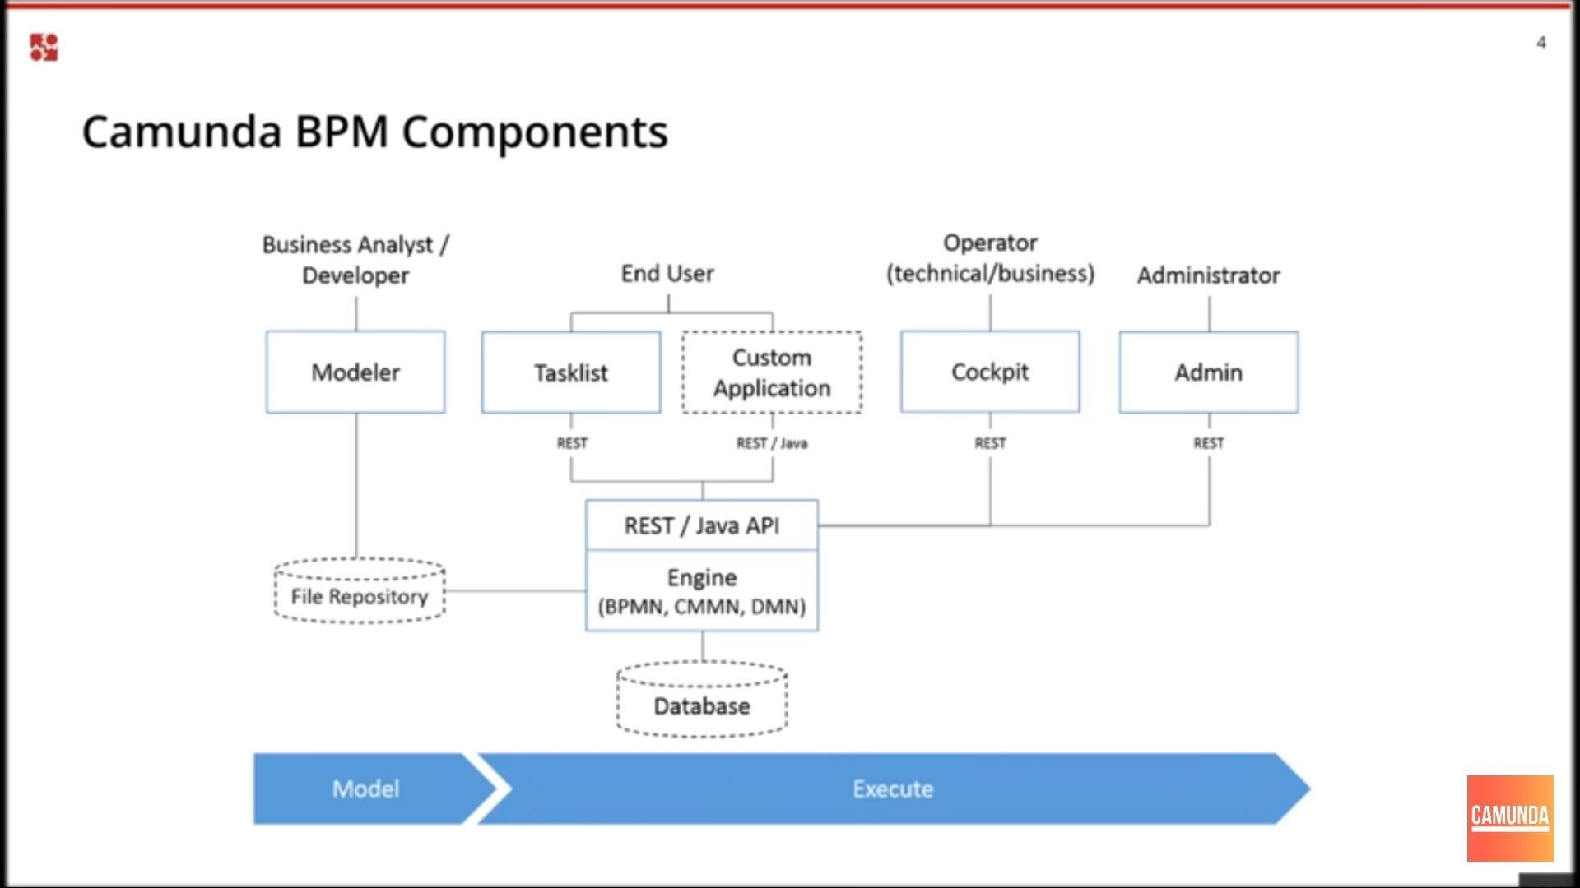
Camunda BPM

Slide 4
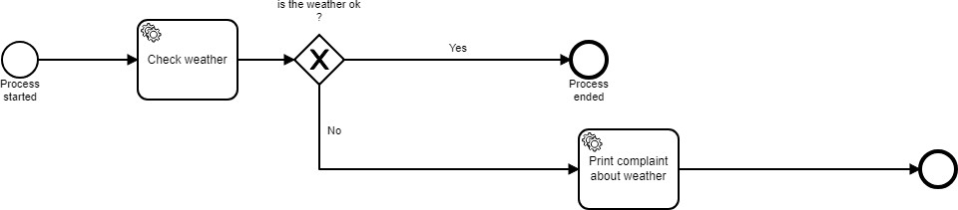
Example of a Process Diagram using Camunda Modeller

Slide 5
Deploying a Java application into Camunda
Install Camunda- open-source community edition and Camunda open-source modeler (to create process diagrams) to create the process diagrams and initiate the further steps of deployment.
Camunda Platform run will be started using “start.bat” (Windows) or “start.sh” (Linux).
Go to localhost:8080 once “start.bat” starts running. Once logged in we can see the cockpit and the Tasklist.
Install WildFly server for Camunda Enterprise edition. For the java code and establishing a connection with Camunda BPM we will be require to create an archetype initially while creating a new Java-Maven project.
The Group ID and the artifactId is mentioned. Create two java files and based on those variables of “weatherOk” and the class path of the files rename the same in “proces.bnpn” diagram as well in the properties section.
Before beginning to open “start-camunda.bat” in Enterprise Camunda BPM Edition make sure to install JDK and add the path “C:\Windows\System32” to the PATH value of Environmental variables.
Build the Java code in IntelliJ IDE, run the command “mvn clean install” and click on war plugin’s “war: war” to generate the WAR file for the project that will be given to Camunda BPM
Place the war file generated in the below said path of the WildFly server folder.
Run several instances of the cockpit after running “start-camunda.bat”

Slide 6
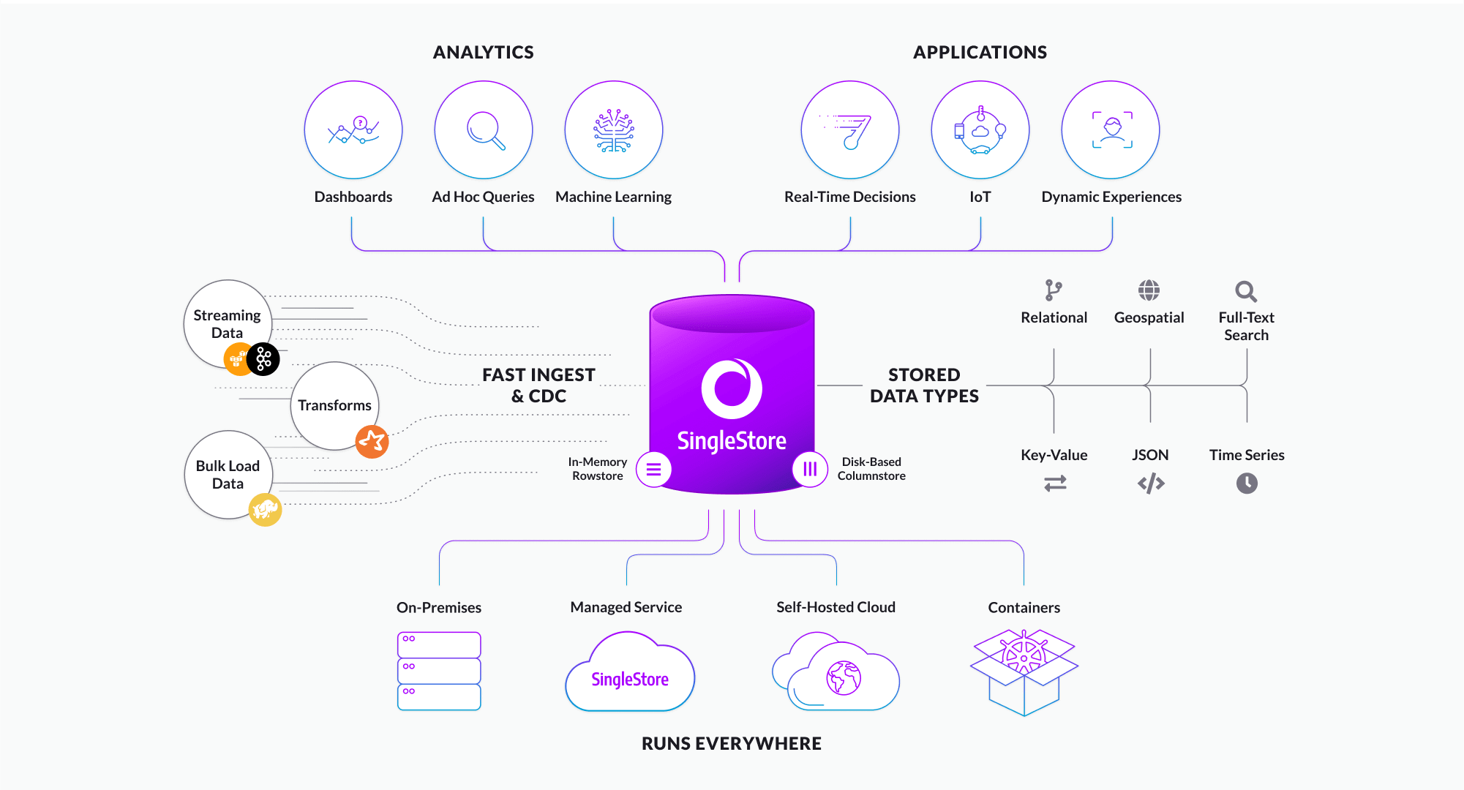
SingleStore SQL

Slide 7
Why and When to Use SingleStore
Both a transactional database and analytical data warehouse.
Real-time Analytics.
Scalability.
How SingleStore DB Works:
Data Ingestion
High-Performance for OLTP and OLAP Workloads
Analysing Data
Deploy anywhere.
Highly compatible.

Slide 8
Using JSON in SingleStore
1) {
“key-name”: “string Value”,
“another-key”: “hello world”
}
myJSON[“key-name”] => “string Value”
Structured and Schema-less: While structured in key-value pairs, JSON is schema less by nature. Values can be numbers, strings, Booleans, nulls or even nested JSON objects or arrays.
Defining JSON columns: CREATE TABLE assets (
tag_id BIGINT PRIMARY KEY,
name TEXT NOT NULL,
description TEXT,
properties JSON NOT NULL
);

Slide 9

Building a SingleStore application Using Flask and Python

Slide 10
Building and Configuring SingleStore Application using Flask
Install VS Code Editor or Sublime Text Editor. Install python and flask using virtual environment (Anaconda prompt).
Create a “server.py” code in your python directory (importing flask packages) and import the necessary packages in Flask. Run the python file in Anaconda prompt. Go to localhost://5000, we can see the web page or string rendered using flask file.
For rendering multiple HTML pages, one has to create database connectivity
between cluster of SingleStore and the python file.
Create the SingleStore cluster and under Connections note the admin password and the host name parameters required to establish connection with SingleStore.
Execute the queries required to create the tables and also in the python file for
creating multiple user entries.
Restart the Anaconda prompt and execute the python file and then we will be able to view HTML pages in https://localhost:5000

Slide 11
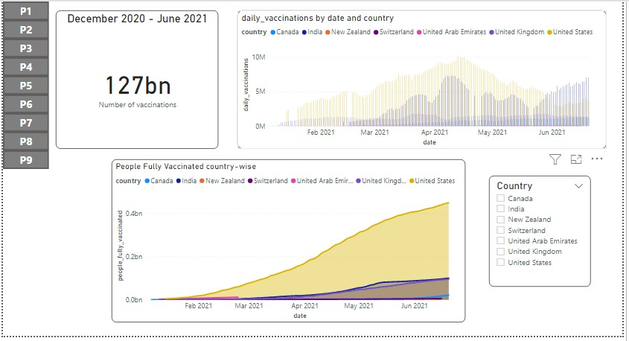
Covid Dashboard Page 1

Slide 12
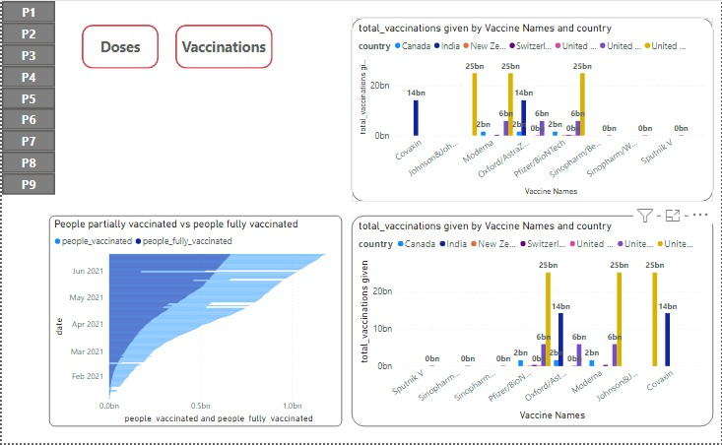
Covid Dashboard Page 2

Slide 13
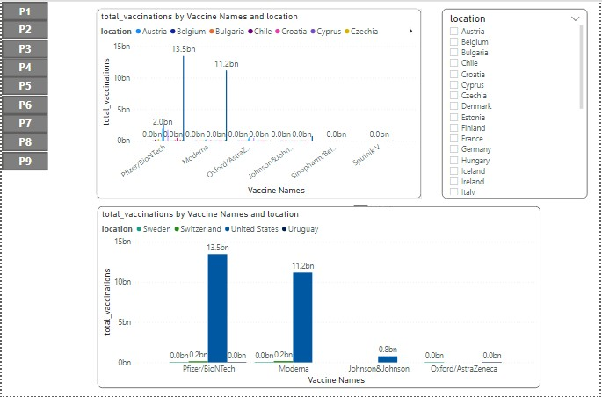
Covid Dashboard Page 3

Slide 14
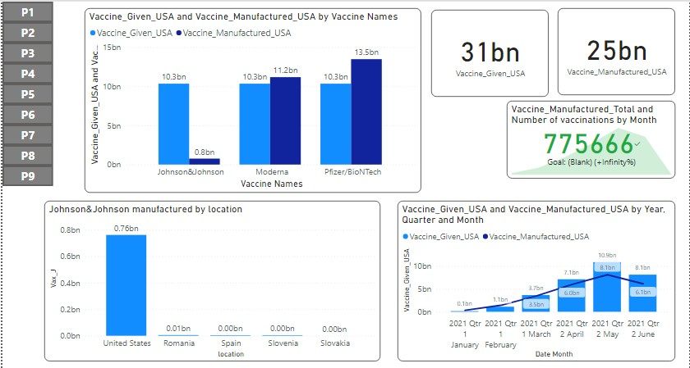
Covid Dashboard Page 4

Slide 15
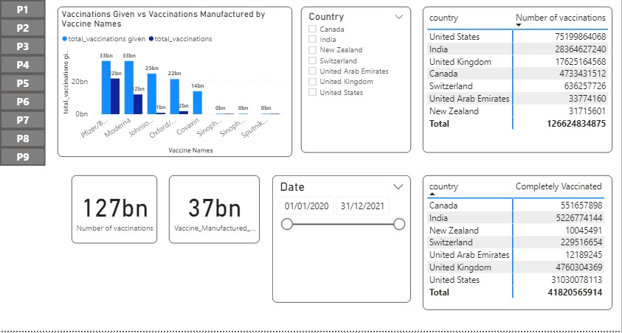
Covid Dashboard Page 5

Slide 16
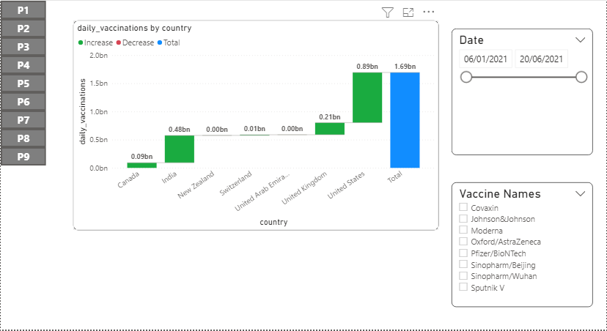
Covid Dashboard Page 6

Slide 17
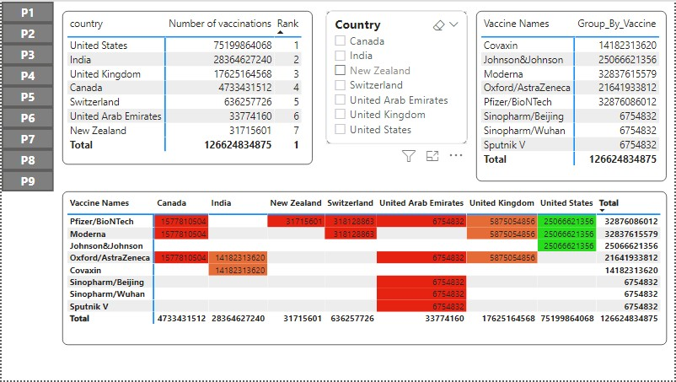
Covid Dashboard Page 7

Slide 18
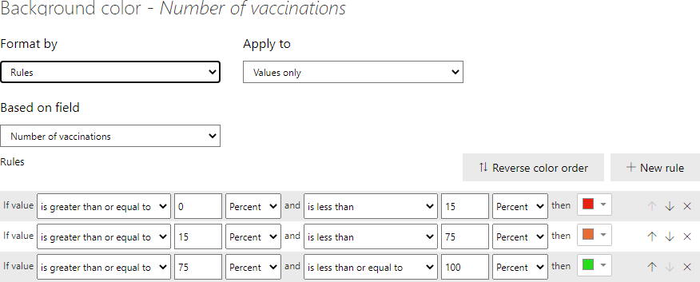
Covid Dashboard Page 7

Slide 19
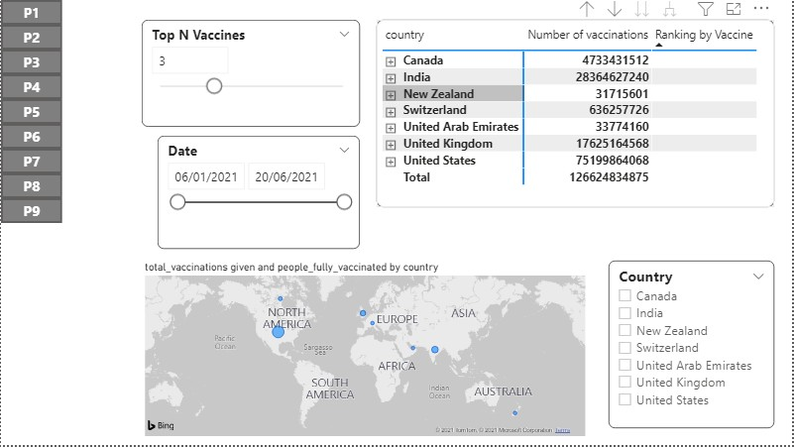
Covid Dashboard Page 8

Slide 20
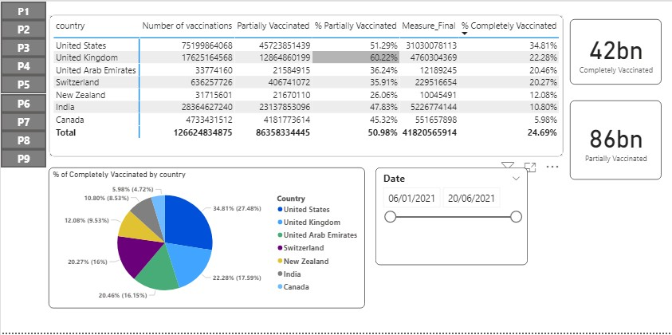
Covid Dashboard Page 9

Slide 21
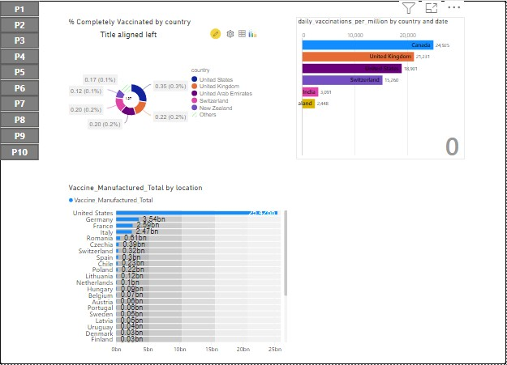
Covid Dashboard Custom Visuals

Slide 22
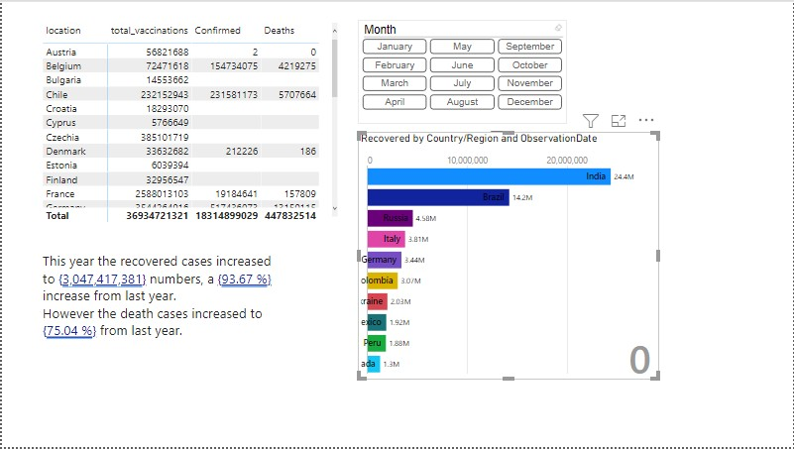
Covid Dashboard Smart Narrative

Slide 23
References
For additional Information on Microsoft Power Bi please refer: https://docs.microsoft.com/en-us/power-bi/
For Additional Information on DAX please refer:
https://docs.microsoft.com/en-us/dax/

